Slide 1
Immersive Python Workshop Day 2 | Git & GitHub

Slide 2
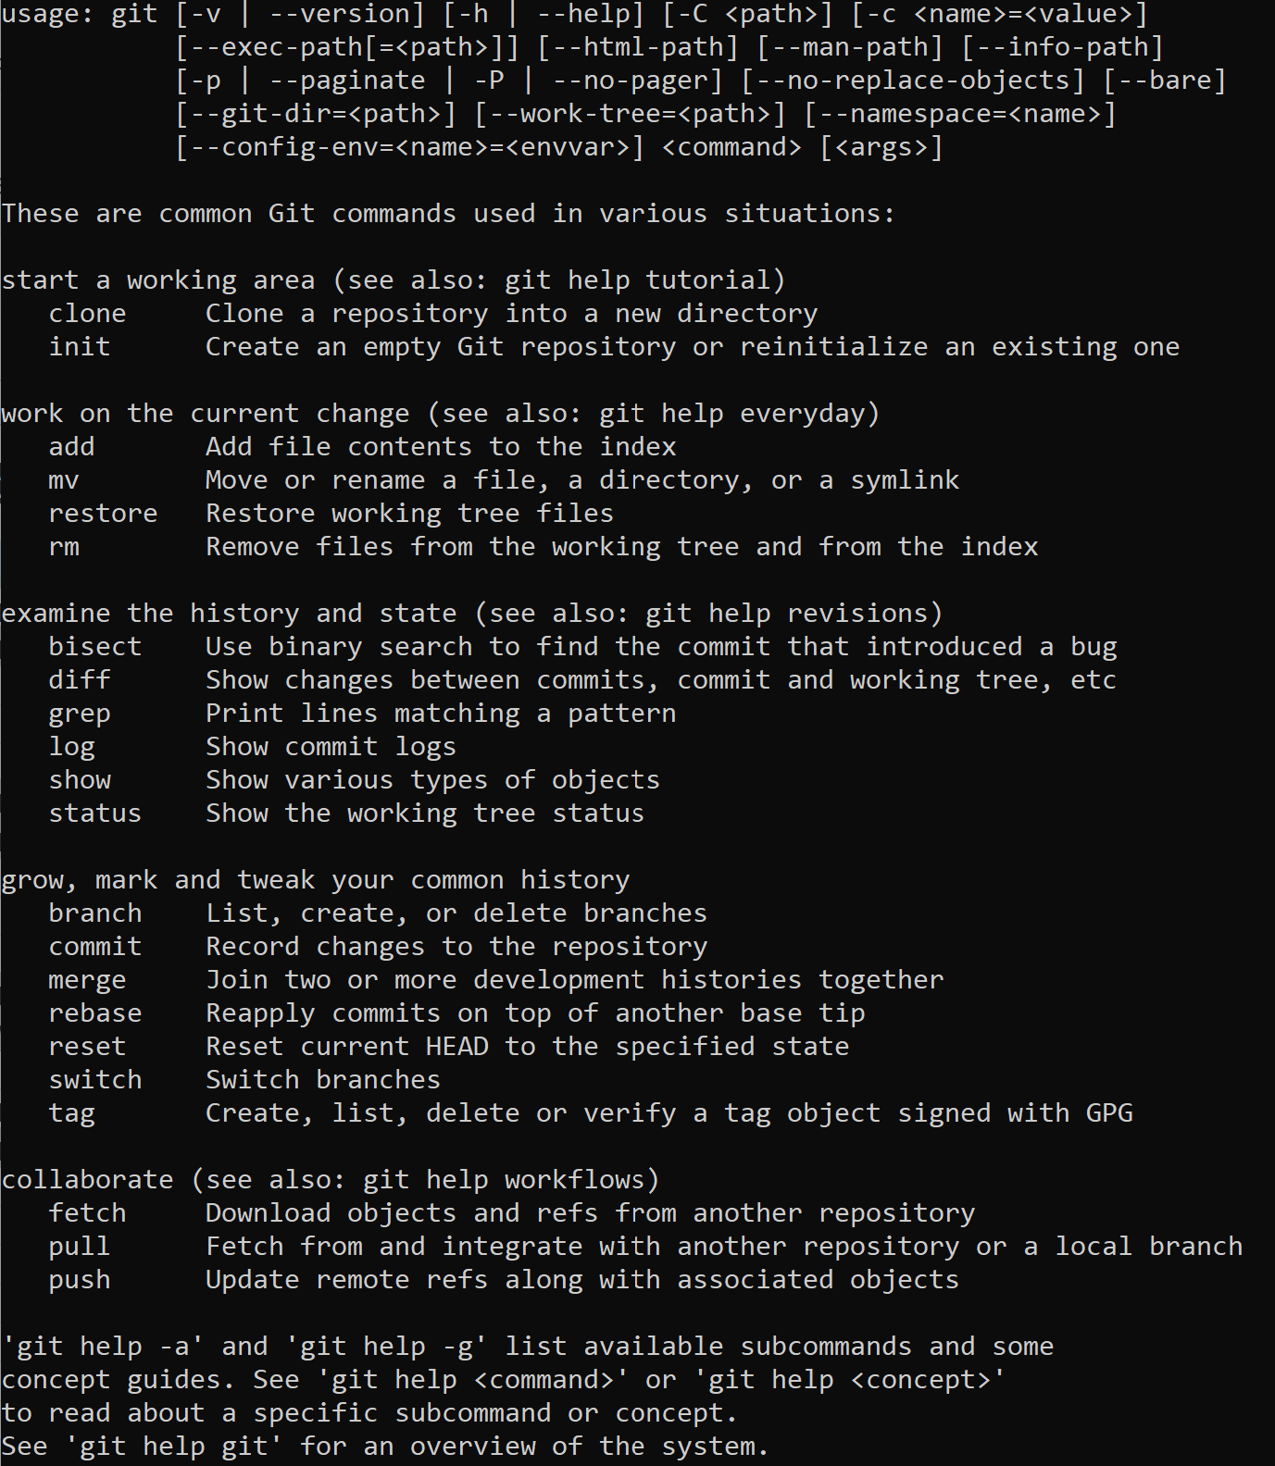
Introduction to Git
https://git-scm.com/downloads
Distributed version control system
Free and open source
Cross platform compatible
Run via Terminal or Command Prompt

Slide 3
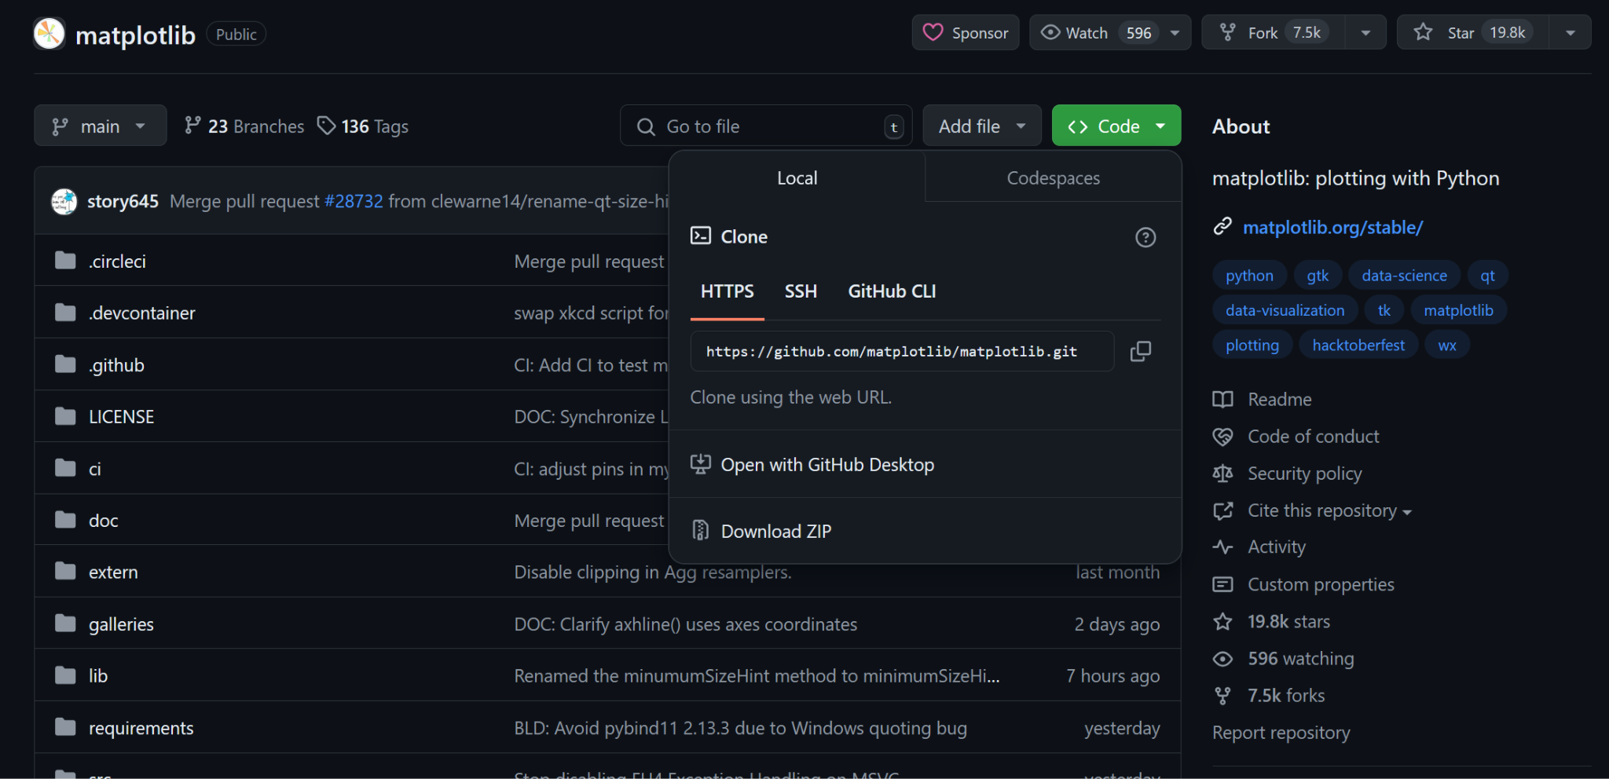
Commonly Used Git CLI Commands
Clone
Init
Add
Commit
Remote
Push
Pull
A detailed overview of all git commands can be found https://training.github.com/downloads/github-git-cheat-sheet/

Slide 4

Introduction to GitHub
GitHub is a great platform for backing up, versioning, collaborating on, and sharing code
It can be a great tool for researchers who want to make their work transparent and replicable
http://github.com vs. http://github.austin.utexas.edu/ (for faculty & staff)
You can use GitHub to publish code for your own projects or to contribute to other software projects for which you are a collaborator or which have been released as open source

Slide 5

Why Push Research Code to GitHub
Get recognition for the coding work that you have done
Share your work with others so that your code can have a greater impact
Make code backups and versioning relatively easy
Potentially benefit from others finding bugs and submitting pull requests for code improvements
Enterprise GitHub and private repositories allow for secure and controlled code management
Help make your research workflows reproducible

Slide 6


GitHub Terminology to Know
Git Open source software used to track and manage versions of files containing text
Repository A container for all of a projects files, they can be open or private
Commit An individual change to a set of files in a repository
Versioning Tracking and saving records of changes to files over time
Pull request Proposed changes to a files in a repository that can be accepted or rejected
ReadMe File A file that defines the content on the repo landing page and provides essential project info
Git Ignore File A file in a git repository that describes files which should not be shared publicly

Slide 7
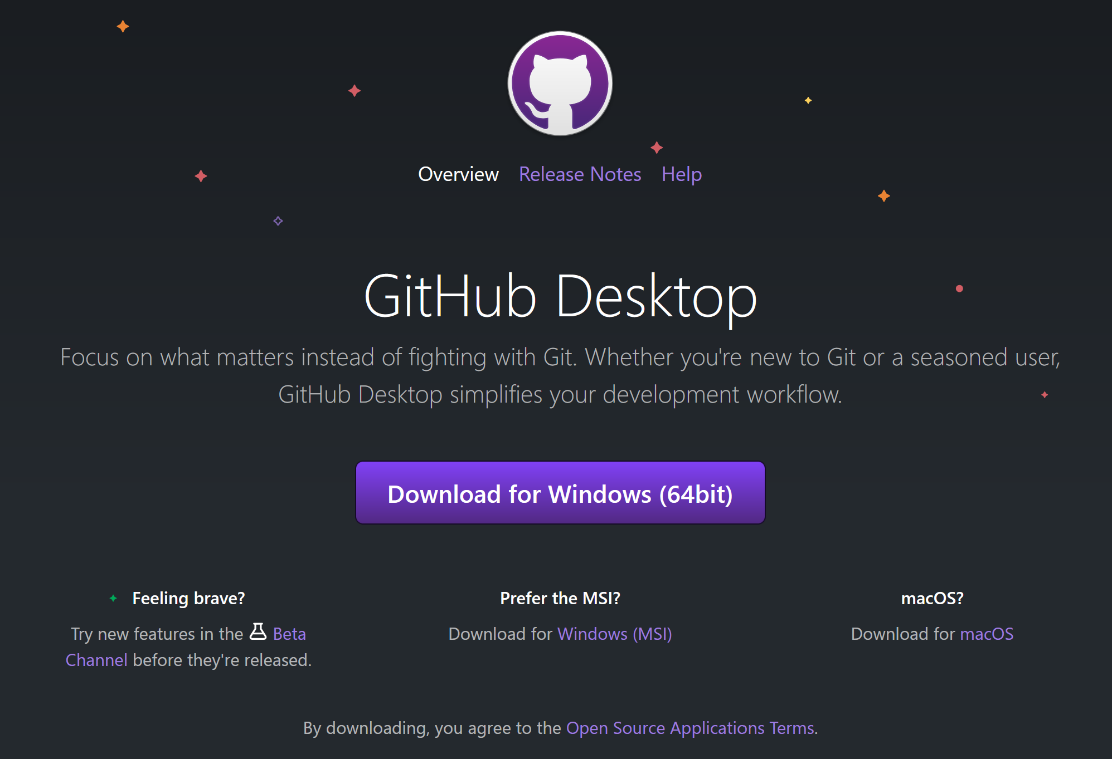
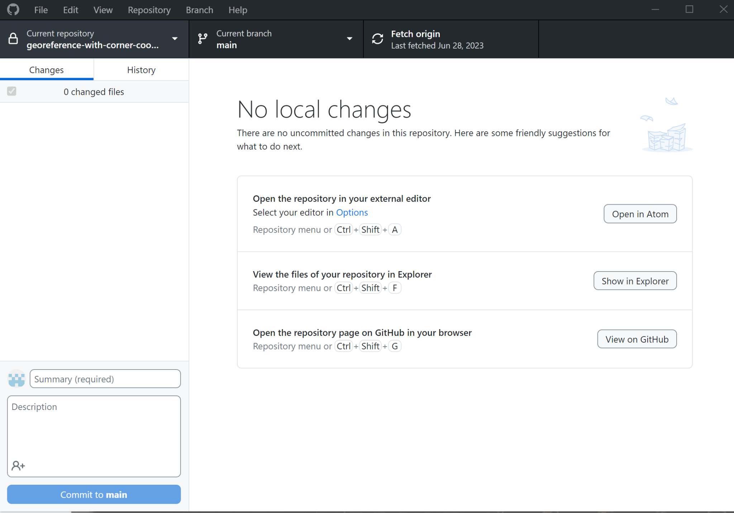
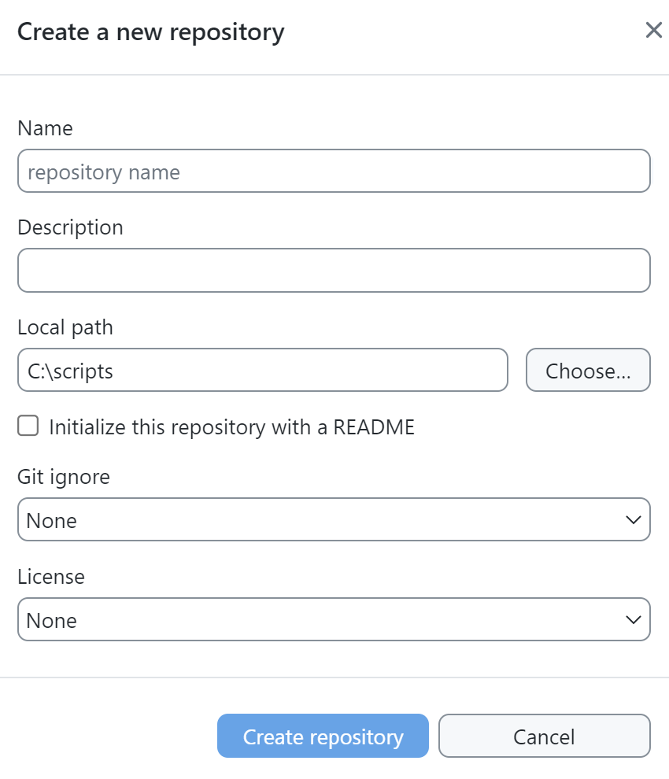
Getting Started with GitHub
Create a GitHub account
Download and install GitHub Desktop (already on lab computers)
Create a new repository in GitHub
Connect GitHub Desktop to your personal GitHub and clone the new repository created in step 3 down to your computer
Copy your Python script file that you created earlier today and past it into the repository on your computer
Make an initial commit using GitHub Desktop
Push the code from your local repository to your GitHub account

Slide 8
Other GitHub Skills to Practice
Edit .gitignore file
Fill out README file
Fork an existing open source repository
Submit a pull request

Slide 9
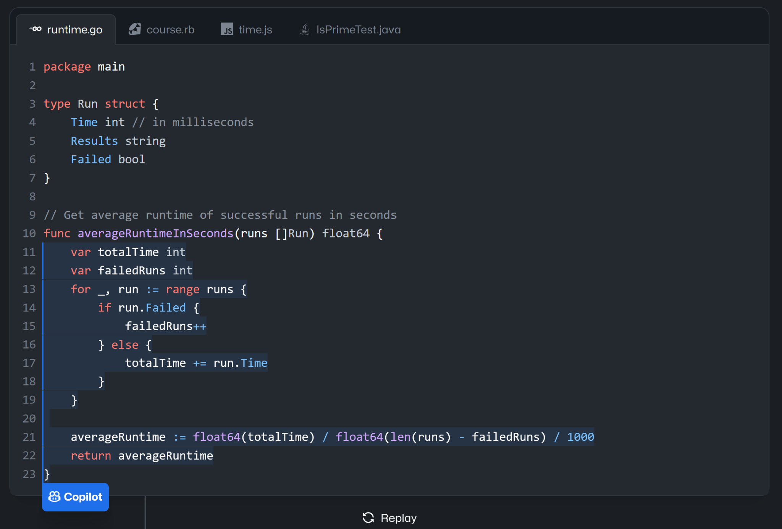
GitHub Copilot
https://github.com/features/copilot
Recently announced free tier with 50 completions per month (link)
Good for help with adding new code snippets within a project
Extension in VS Code can be used for free by students, faculty, & open source project maintainers
https://docs.github.com/en/copilot/managing-copilot/managing-copilot-as-an-individual-subscriber/managing-your-copilot-subscription/getting-free-access-to-copilot-as-a-student-teacher-or-maintainer

Slide 10



Selecting a Software Licensing
If you want others to know how they are permitted to use the code you share on GitHub, you should select a license that clearly defines associated restrictions and obligations
There are many options to choose from, but some like these below are frequently chosen
MIT
BSD 3-Clause
GNU
Apache
Visit https://choosealicense.com/licenses/ for a detailed list of license options
The open source license best practices document on the OSPO site summarizes key considerations

Slide 11





UT Open Source Program Office (UT-OSPO)
The UT Open Source Program Office (UT-OSPO) is a great new resource for developers of research software
Established in 2023 with funding from the Alfred P. Sloan Foundation (Grant Number G-2023-20944)
Director: Angela Newell, Ph.D. (anewell@austin.utexas.edu)
The Office is a partnership between TACC, ITT, the iSchool, & UT Libraries

Slide 12

UT-OSPO Vision
Focus on faculty, post-docs, grad students - helping them interact with the open source communities for the tools that they use.
Engage faculty and students in an open source participation pathway advancing basic use of open source software through contribution, sharing, accepting external contributions, and ultimately developing an ecosystem of related open source projects.
Develop a community of researchers who use, contribute to or develop open source code and a program office that embraces and supports researchers at every step of the pathway from using code to developing software

Slide 13
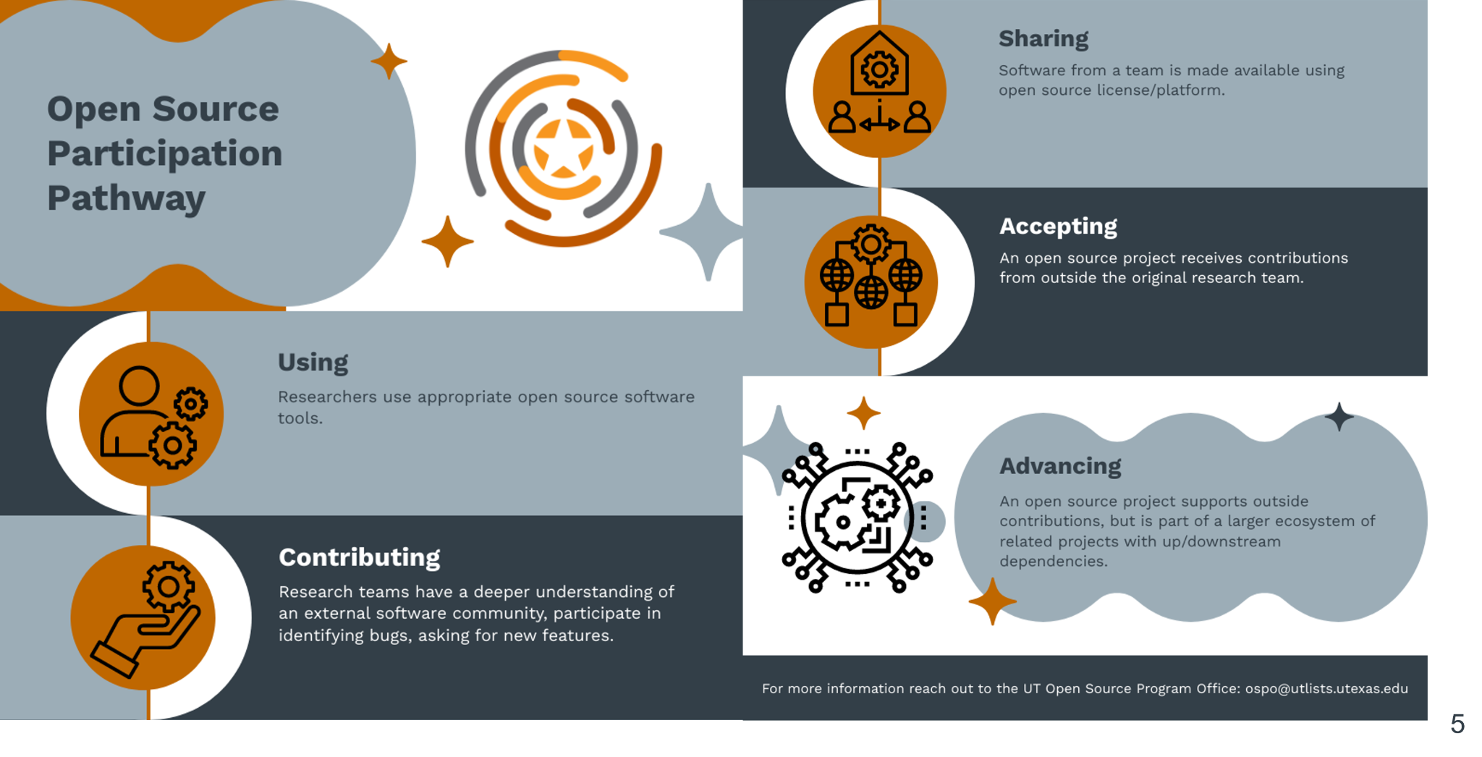

Slide 14
How Can the OSPO Help Researchers?
Training/Events
Funding Identification
Best practices guides
Consultation Services

Slide 15
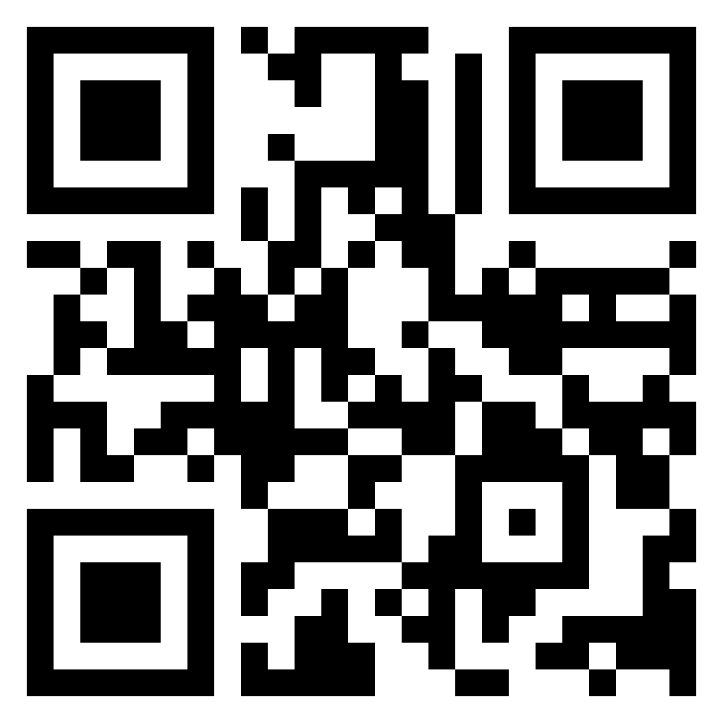
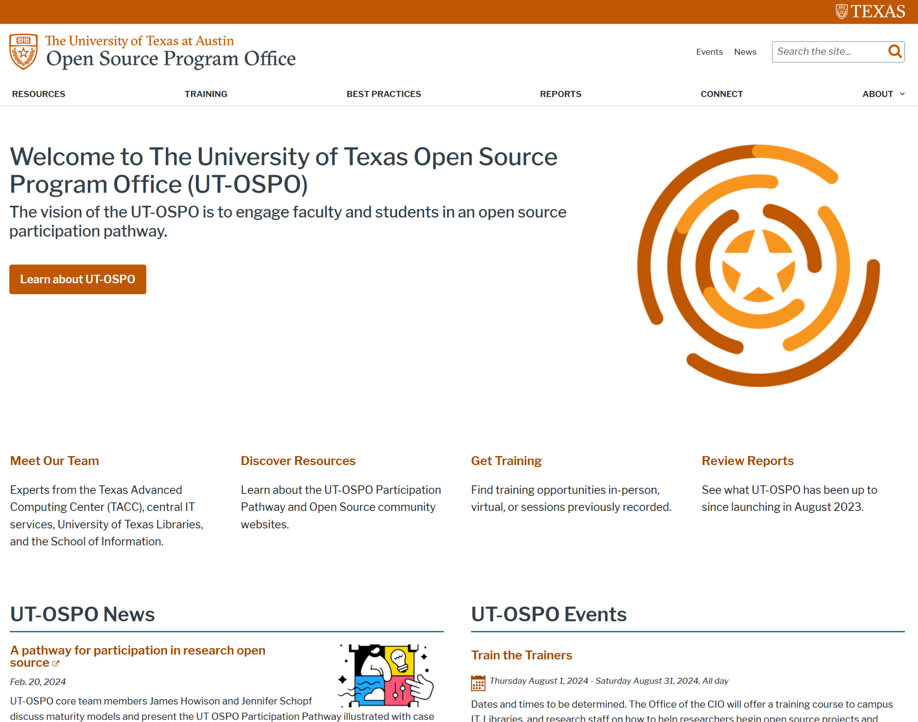
How to Connect
Contact us at: ospo@utlists.utexas.edu
Visit our website: www.opensource.utexas.edu (or us QR code below)
Sign up to receive emails: https://utlists.utexas.edu/sympa/subscribe/ospo.announce
Book a consultation: https://outlook.office365.com/book/UTOSPOOpenSourceSoftwareConsultation@utexas.onmicrosoft.com/

Slide 16

Upcoming Spring Workshops & Events
What Workshops covering research data practices and software
When On the following dates: 1/31, 2/11, 2/12, 2/13, 2/14, and 2/28
Time 12pm - 1:15pm
Where Zoom (all dates) / PCL Scholars Lab (select dates)
More info https://guides.lib.utexas.edu/data-and-donuts
Data & Donuts Workshop Series
What Comprehensive introduction to key UT research computing resources
When Fri. April 4th 2025, 10am - 12pm
Where PCL Scholars Lab
Research Computing Resource Fair

Slide 17
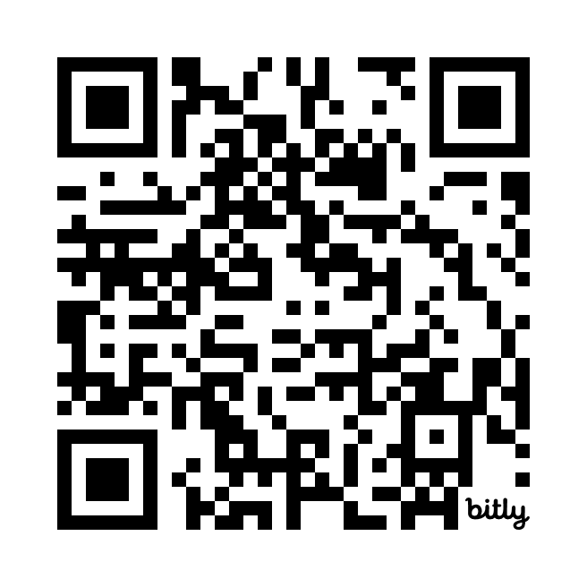
Workshop Wrap Up
Thank you for attending!
Any questions?
Please provide Day 2 feedback in the shared notes document at https://bit.ly/ipw-jan2025

